Slide 1
Udacity DFND
Project 2: Analyze Survey Data
by
Sai Saranya Gurram

Slide 2
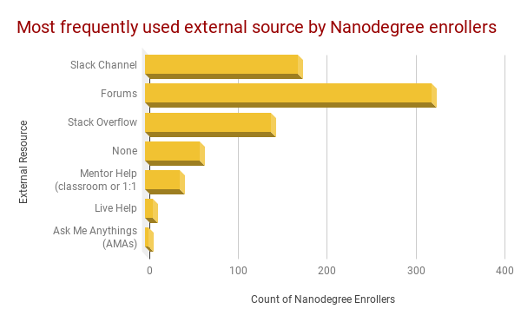
Which external resource is most used during Nanodegree Program(s)?
This Bar Chart shows the distribution of students participation in external resources during Nanodegree program.
From the chart, we can say that students show more interest in discussing through Udacity forums and then through slack channels. Eventhough slack channels are more interactive than forums, students show more interest towards forums. This may be due to the ease in following-up each topic or so.

Slide 3
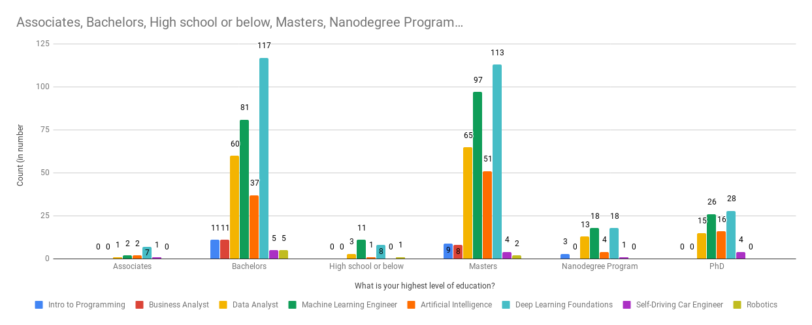
Which is the most popular Nanodegree chosen among students with Masters?
The above Column Chart shows the choice of nanodegree and their highest level of education. From this we can analyse that the students with Masters has shown more interest towards Deep Learning Foundations and then in Machine Learning Engineer Nanodegree programs.

Slide 4
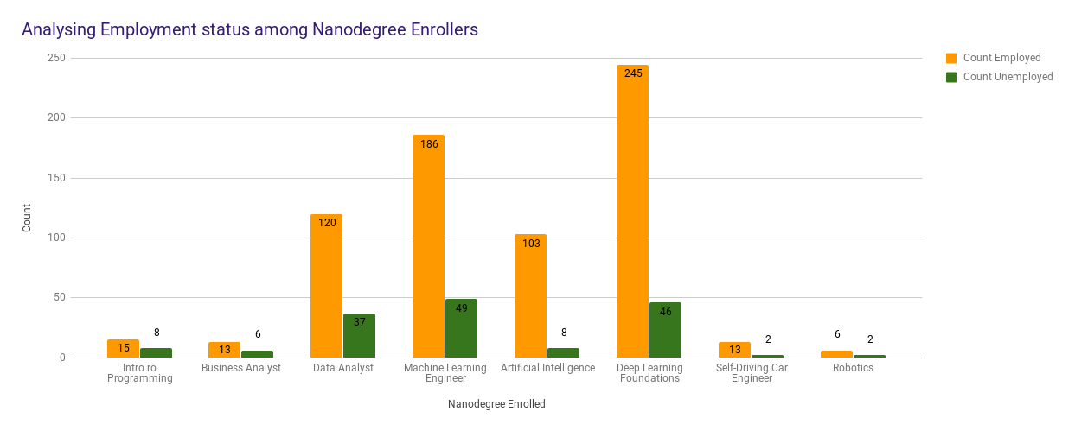
What is the employement status among the Nanodegree enrollers?
From this Column Chart it is clear that there are more number of employed students than unemployed students participating in nanodegree programs. Also, we can analyse that both employed as well as unemployed students show more interest towards DL and ML programs.
Nanodegree | IP | BA | DA | ML | AI | DL | SDC | Robotics
Count - Employee | 15 | 13 | 120 | 186 | 103 | 245 | 13 | 6
Count - Unemployee | 8 | 6 | 37 | 49 | 8 | 46 | 2 | 2

Slide 5
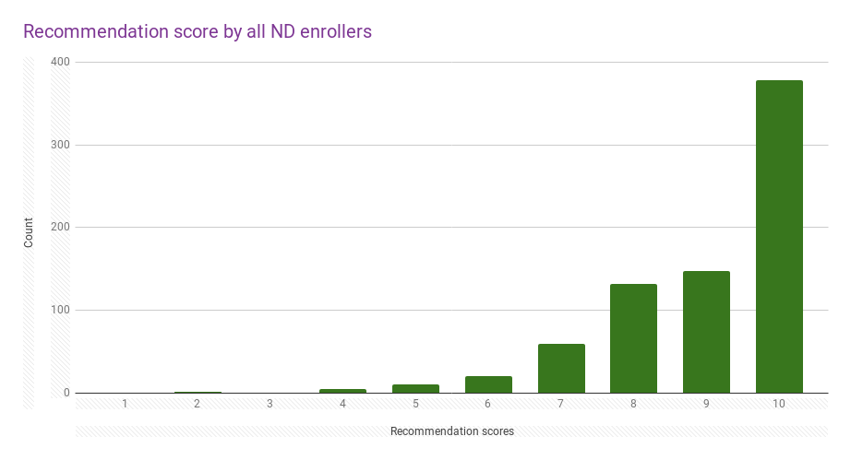
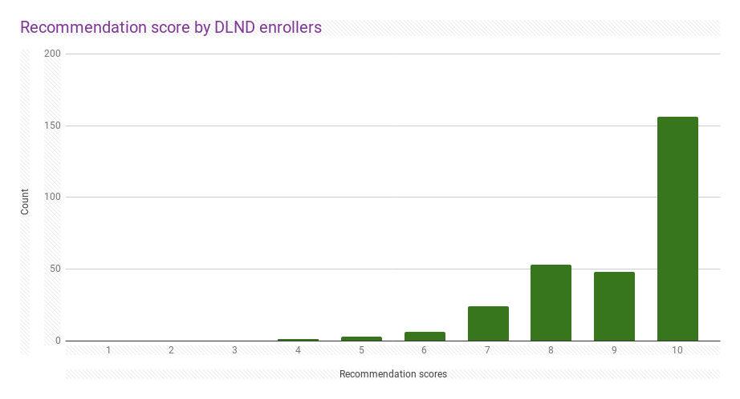
What is the relationship between Overall and DL foundations recommendation scores?
On observing the mean values of overall as well as DL foundations, we can say that DL foundations is not only most popular ND with high enrollment but also it is most recommended ND that others. Also, the above two graphs are left skewed, which means Mean<Median<Mode. Here Median=Mode=10, implies almost all the students are likely to recommend their enrolled ND to others. The standard deviation of Overall recommendation scores to that of DL foundations is a bit more, which indicates, that the spread of data is a bit wider in overall than Dl foundations recommendation scores.
 | Overall | DL
Mean | 8.98 | 9.07
Median | 10 | 10
Mode | 10 | 10
STDEV | 1.36 | 1.22

Slide 6
Acknowledgement
Thank you!
Note: This data is from Survey Respondents and is not from the entire Udacity Student population. Hence the results obtained from this analysis cannot be extrapolated to whole Udacity Student Population.

